Slide 1
The Printing Opportunity
High Quality Printing, with Great Service,
and Better for the Environment.

Slide 2
What We Have Now
Slow Service
Expensive
Low Quality

Slide 3
What’s Out There in the Market
Self-Service
Huge Price
Complicated Ordering

Slide 4
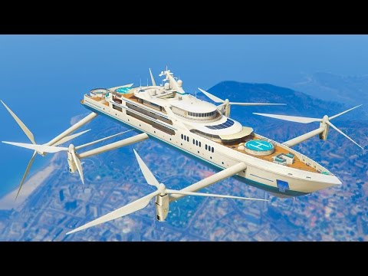
What We Want
High-Quality
Great Service
Environmentally Friendly

Slide 5
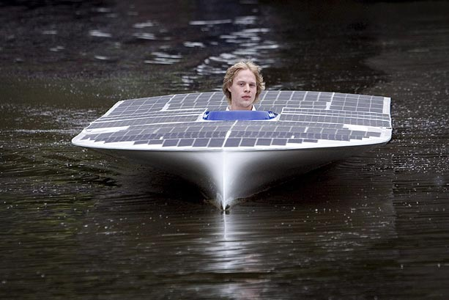
What We’ve Found
Latest Technology
Great Reviews
Super Green Company

Slide 6
Migration Plan
Sunset Current Vendor
Launch New Partner
Close out all orders past next month.
Notify vendor to discontinue automated orders by XX/XX.
Update internal vendor assignments for all new orders by XX/XX date.
Have administrative update billing records and best practice documents by XX/XX date.
Setup templates and upload visual assets for future print jobs by XX/XX date.
Create new orders in their system by XX/XX date.
Work with administrative to update billing records and best practice documents by XX/XX date.

